Slide 1
การใช้งาน phpMyAdmin และระบบ Blog
สมเกียรติ ใจดี
สัปดาห์ที่ 2 วันที่ 13 มิถุนายน 2567

Slide 2
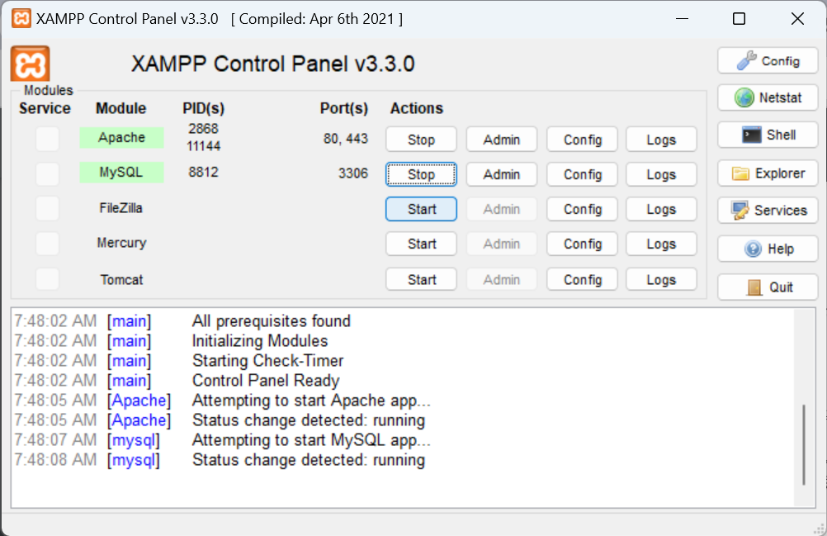

Slide 3
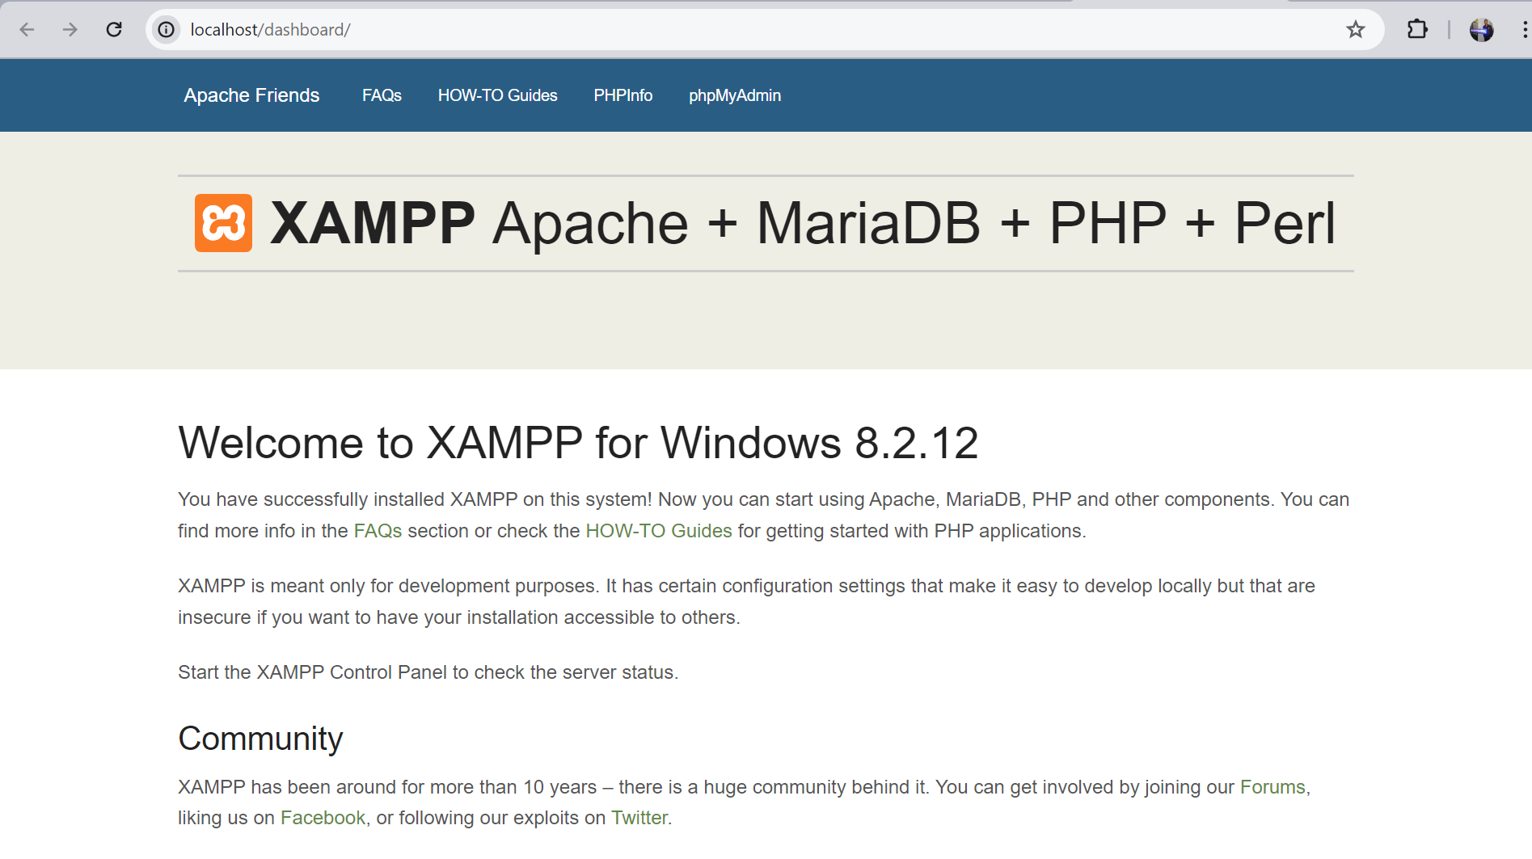

Slide 4
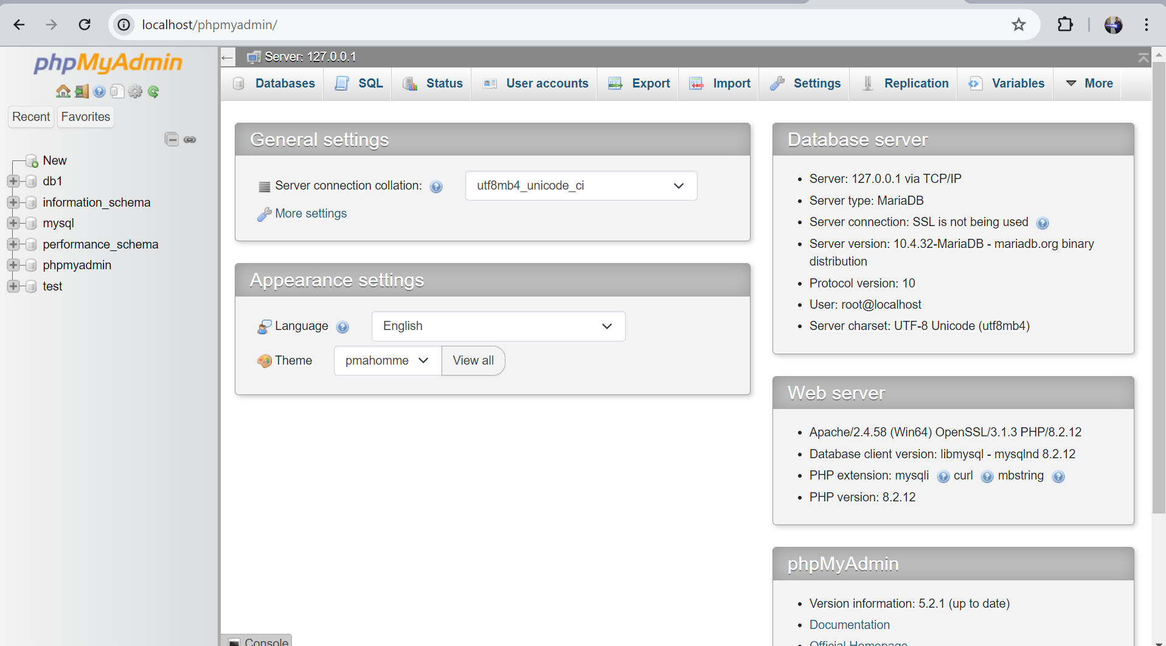

Slide 5
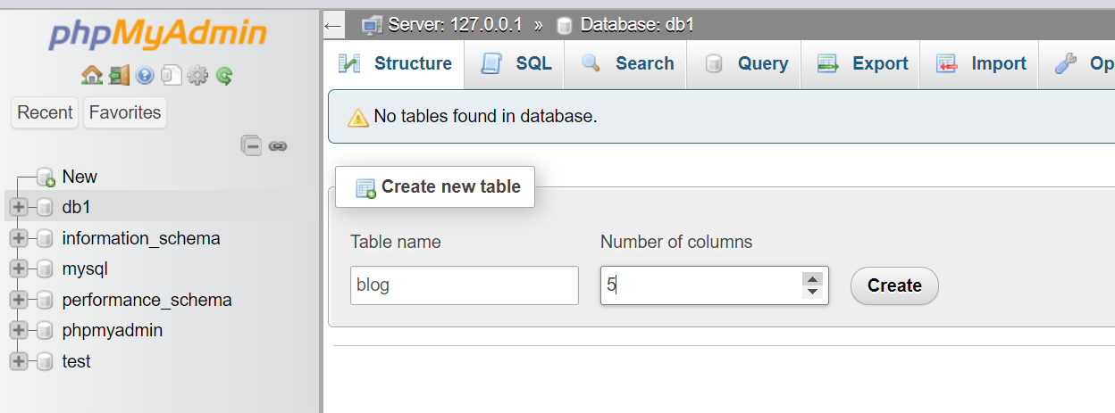

Slide 6
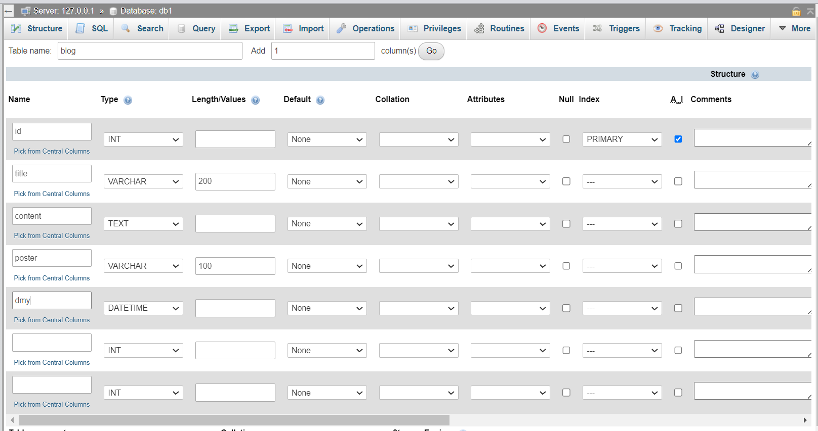

Slide 7
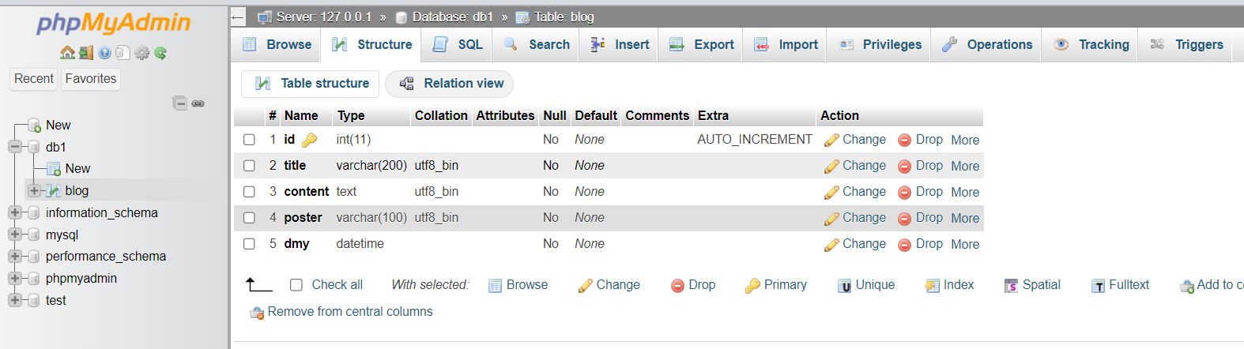

Slide 8
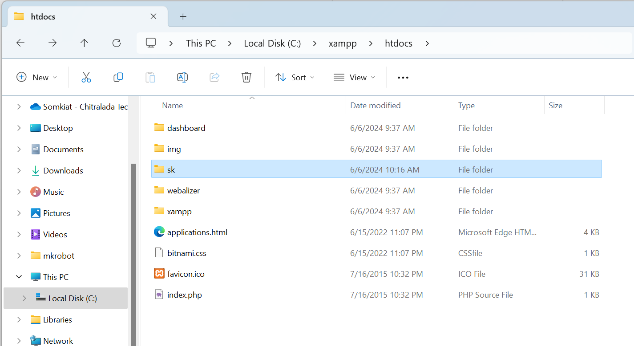

Slide 9
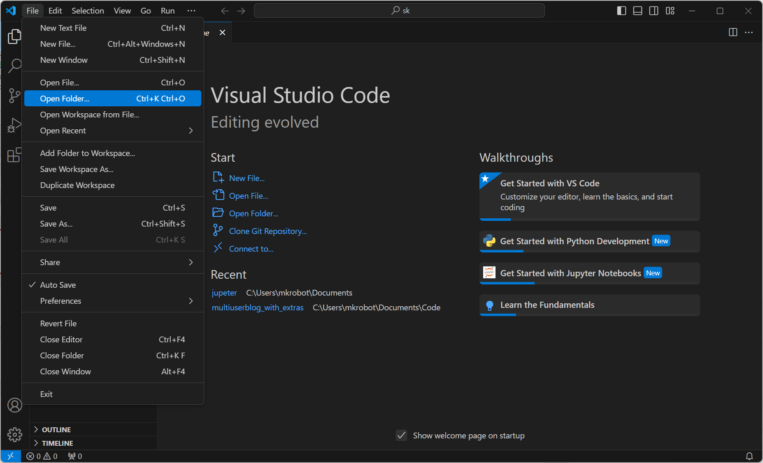

Slide 10
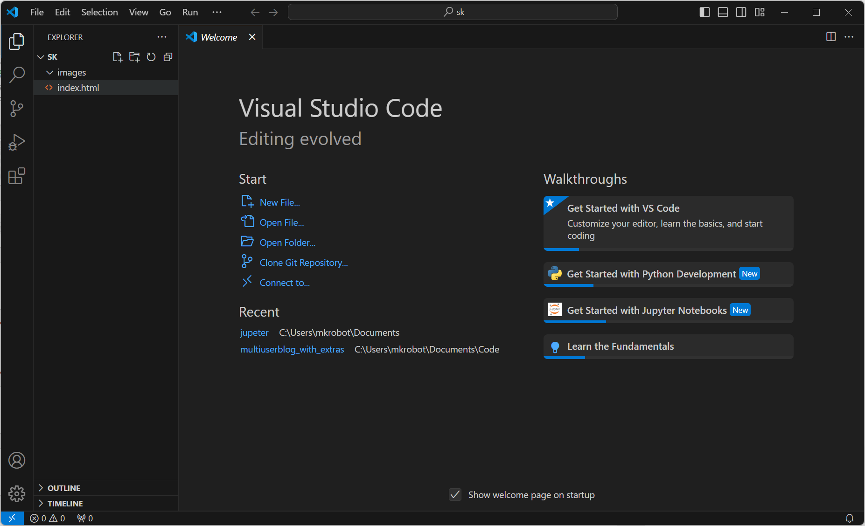

Slide 11
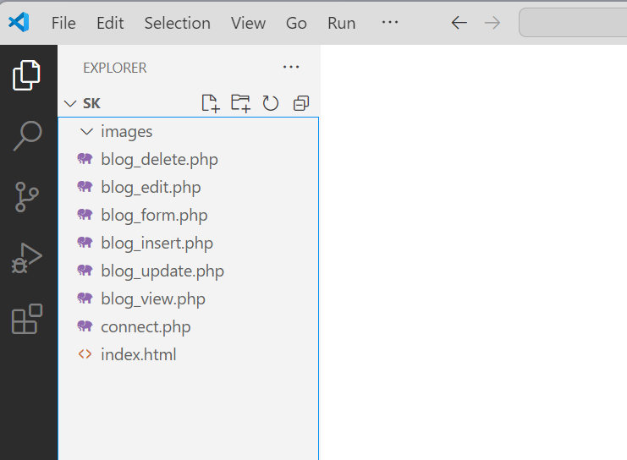

Slide 12
connect.php
<?php
$servername = "localhost";
$username = "root";
$password = ""; //ใน xampp ไม่ต้องระบุ password
$dbname = "db1"; //กำหนดชื่อฐานข้อมูล
// Create connection
$conn = new mysqli($servername, $username, $password, $dbname);
// Check connection
if ($conn->connect_error) {
die("Connection failed: " . $conn->connect_error);
}
?>

Slide 13
blog_form.php
<!DOCTYPE html>
<html lang="en">
<head>
<meta charset="UTF-8“/>
<meta name="viewport" content="width=device-width, initial-scale=1.0“/>
<title>Blog Form</title>
</head>
<body>
<form action="blog_insert.php" method="post">
ชื่อเรื่อง : <input type="text" name="title" /> <br/>
เนื้อหา : <textarea name="content"></textarea > <br/>
ผู้โพสต์ : <input type="text" name="poster" /> <br/>
<input type="submit" value="ส่งข้อมูล" />
</form>
</body>
</html>

Slide 14
blog_insert.php
<?php
include "connect.php";
$sql = "INSERT INTO blog (title, content, poster, dmy)
VALUES ('$_POST[title]', '$_POST[content]', '$_POST[poster]', now())"; // blog คือชื่อตารางที่จะบันทึก
if ($conn->query($sql) === TRUE) {
echo "New record created successfully";
} else {
echo "Error: " . $sql . "<br>" . $conn->error;
}
$conn->close();
?>

Slide 15
blog_view.php
<?php
include "connect.php";
$sql = "SELECT * FROM blog";
$result = $conn->query($sql);
if ($result->num_rows > 0) {
// output data of each row
while($row = $result->fetch_assoc()){
echo "ID: ".$row["id"]."<br>";
echo "Title: $row[title] <br/>";
echo "Content: $row[content] <br/>";
echo "Poster: $row[poster] <br/>";
echo "Date: $row[dmy] <br/>";
echo "<a href='blog_delete.php?id=$row[id]'> ลบ </a> ";
echo "&nbsp &nbsp";
echo "<a href='blog_edit.php?id=$row[id]'>แก้ไข </a> ";
echo "<hr/>";
}
} else {
echo "0 results";
}
$conn->close();
?>

Slide 16
blog_delete.php
<?php
include "connect.php";
// sql to delete a record
$sql = "DELETE FROM blog WHERE id=$_GET[id]";
if ($conn->query($sql) === TRUE) {
echo "Record deleted successfully";
header( "location: blog_view.php" );
exit(0);
} else {
echo "Error deleting record: " . $conn->error;
}
$conn->close();
?>

Slide 17
blog_edit.php
<!DOCTYPE html>
<html lang="en">
<head>
<meta charset="UTF-8">
<meta name="viewport" content="width=device-width, initial-scale=1.0">
<title>Blog Form</title>
</head>
<body>
<?php
include "connect.php";
$sql = "SELECT * FROM blog";
$result = $conn->query($sql);
$row = $result->fetch_assoc()
?>
<form action="blog_update.php" method="post">
<input type="hidden" name="id" value="<?php echo $row['id'] ?>" />
ชื่อเรื่อง : <input type="text" name="title" value="<?php echo $row['title']; ?>" /> <br/>
เนื้อหา : <textarea name="content"> <?php echo $row['content']; ?> </textarea > <br/>
ผู้โพสต์ : <input type="text" name="poster" value="<?php echo $row['poster']; ?>" /> <br/>
<input type="submit" value="แก้ไขข้อมูล" />
</form>
</body>
</html>

Slide 18
blog_update.php
<?php
include "connect.php";
$sql = "UPDATE blog SET title='$_POST[title]', content='$_POST[content]' WHERE id=$_POST[id]";
if ($conn->query($sql) === TRUE) {
echo "Record updated successfully";
echo "Record deleted successfully";
header( "location: blog_view.php" );
exit(0);
} else {
echo "Error updating record: " . $conn->error;
}
$conn->close();
?>

